Slide 1

Introduction to Automatic Speech Recognition
How does a machine know what you just said?
Dr. Arróniz | World Languages & Literatures | UNR
Linguistics Club Workshop – April 2026

Slide 2
Agenda
Sound = Numbers
A better way to look at sounds
Understanding sound recognizers
How the big systems do it
What this means for language
https://github.com/sarroniz/workshops

Slide 3
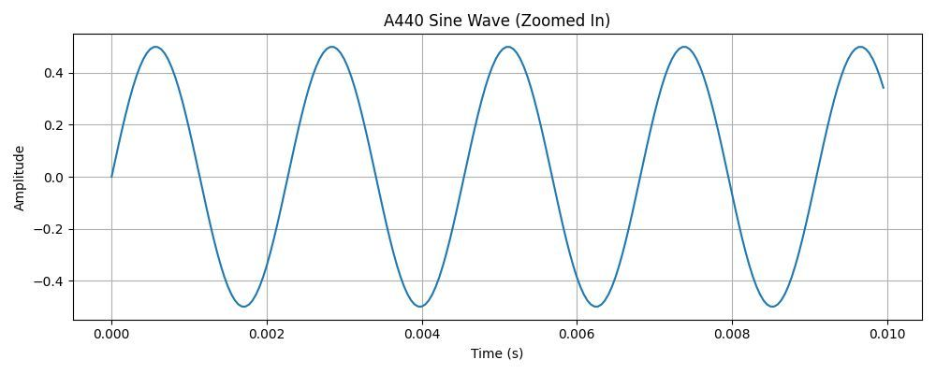
What is a sound?
When you speak, you push air
That moving air creates pressure waves
Your microphone measures those waves 22,000 times per second and turns each measurement into a number
So “hello” becomes something like:

Slide 4
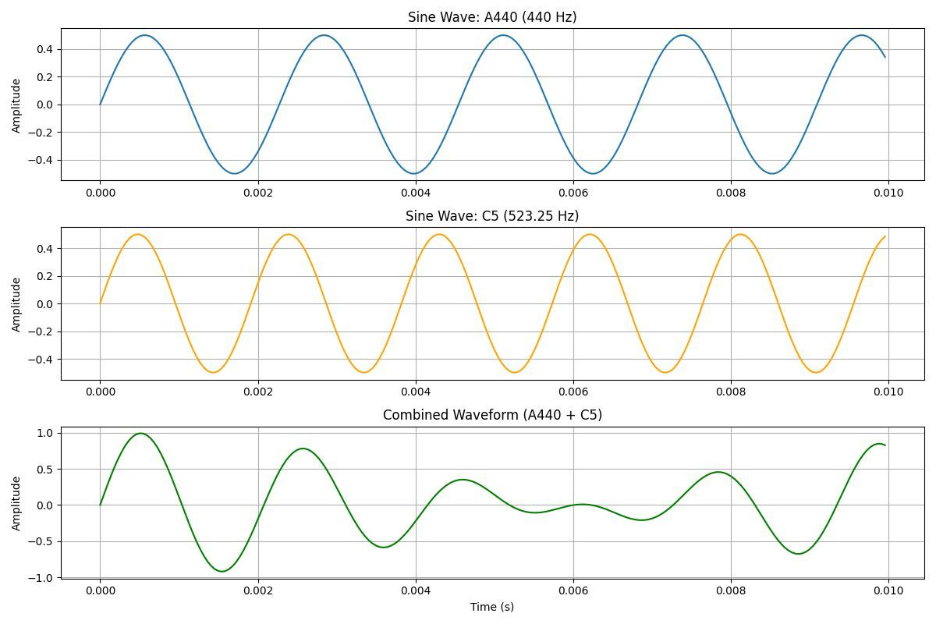
What is a sound?
But it’s not as simple as a single waveform…

Slide 5
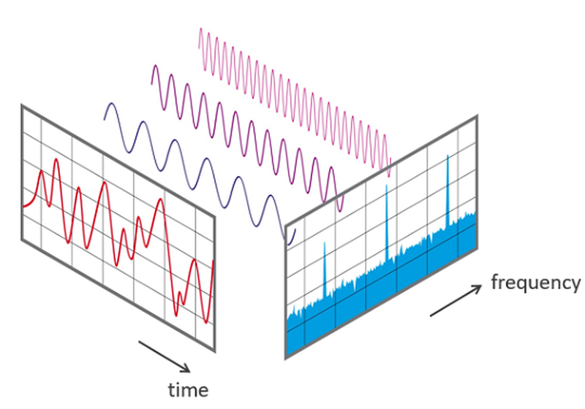
What is a sound?
To separate out the components of a complex waveform, we use a mathematical tool called the Fourier transform
It analyzes a waveform and reveals which frequencies are present and how strong they are
It turns a single, messy signal into a collection of building blocks, like separating a chord into individual notes

Slide 6
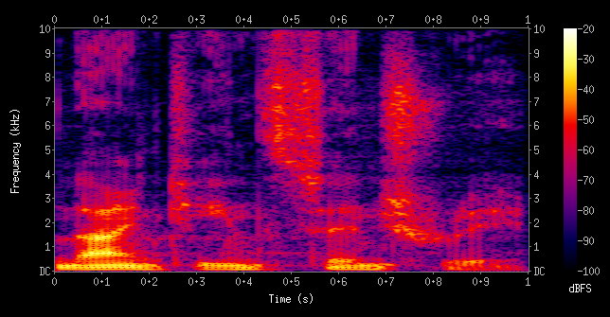
A better way to look at sounds
The raw waveform is hard to work with: it’s like trying to recognize a song by staring at the vinyl grooves
We need a better picture: the spectrogram
A spectrogram uses the Fourier transform to show how a sound’s frequency content changes over time
First, slice the waveform into small time windows
Next, run a Fourier transform on each window to get its frequency breakdown
Finally, stacks those windows in sequence to form a time-frequency graph

Slide 7
A better way to look at sounds
Instead of showing how loud at each moment, it shows which frequencies are present at each moment:
X-axis → time
Y-axis ↑ frequency (low sounds at the bottom, high sounds at the top)
Brightness = energy (how much of that frequency is present)
Think of it like a sheet music vs. audio playback. The waveform is the sound hitting the air. The spectrogram is the score – something you can read and compare

Slide 8
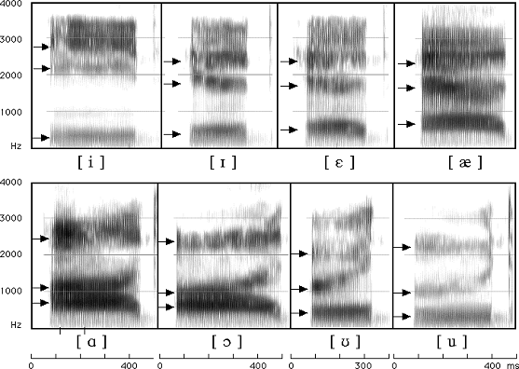
Reading a spectrogram
In a spectrogram, every feature you see corresponds to something your mouth is doing
Formants – the “shape” of a vowel
Dark horizontal bands that run across the spectrogram are called formants
They are the resonant frequencies of your vocal tract – basically, the acoustic signature of the shape your mouth is in
F1 (the lowest band): tracks how open your mouth is F2 (the second band) : tracks how front or back your tongue is F3 (the third band): tracks vocal tract configurations related to rhoticity and lip rounding

Slide 9
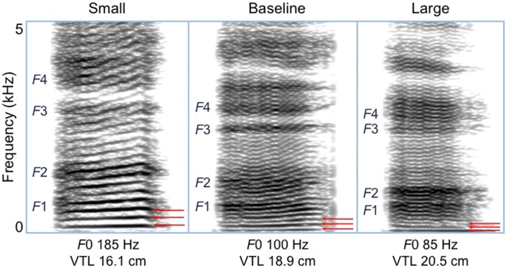
Reading a spectrogram
Pitch (F0) – the fundamental frequency
When your vocal folds vibrate, they produce a periodic signal at your speaking pitch
This shows up as a stack of evenly-spaced horizontal lines at the bottom of the spectrogram (called harmonics)
Voiced sounds (vowels, /v/, /z/, /m/, etc.) → harmonics visible, evenly spaced Voiceless sounds (consonants like /s/, /f/, /p/, etc.) → no harmonics, just noise or silence

Slide 10
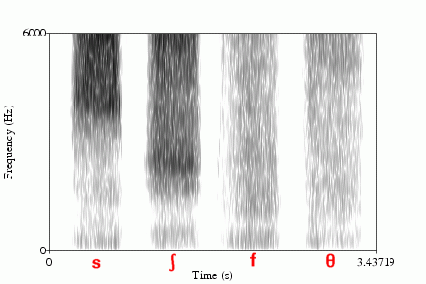
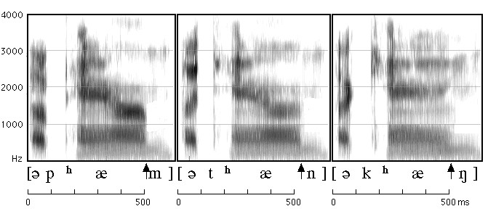
Reading a spectrogram
Frication and burst – the “shape” of a consonant
Fricatives (/s/, /f/, /sh/) appear as a cloud of broadband noise – grainy texture with no clear horizontal structure
Stops (/p/, /t/, /k/) appear as a gap (closure) followed by a sharp vertical burst line (release)

Slide 11
A better way to look at sounds
The problem: numeric representation of the sound will look completely different depending on who speaks, how fast, how loud, or what microphone they use
How do you teach a machine to spot the pattern?
What’s interesting: the same word, spoken by different people, looks remarkably similar on a spectrogram!
That consistent shape is what recognition systems learn to match

Slide 12
Word Recognizer
Download and open recognizer.html in Chrome and allow microphone access
Step 1: Train
Click “Record” next to each word and say it clearly
The app will turn your voice into a spectrogram and save it as a “tamplate” (a picture of what your version of that word looks like)
Step 2: Recognize
Click “Speak and Recognize” and say one of your words
The app turns your new recording into a spectrogram and compares it against every template we have created
The closest match wins
Watch the similarity bars
The machine is not making a decision, it’s measuring distances!

Slide 13
Word Recognizer
Try this:
Train on “yes” and “no” – does it tell them apart?
Have someone else speak – does it still work?
Train and test in a language other than English

Slide 14
What’s actually happening under the hood?
The spectrogram has hundreds of frequency bins
Before comparing, the app compresses it into just 20 numbers per time frame – one for each band of the frequency range, spaced on the mel scale (which matches how humans actually hear pitch)
The result is a small grid: 20 rows x ~50 columns (this grid is the “fingerprint” of your word)
This compression step is the same one used in Whisper, Google, and every other modern ASR system. You just watched the app do it live.
Raw Audio | Spectrogram | Mel features
44,000 numbers/sec | Full frequency image | 20 numbers/frame
Hard to compare | Visual, but big | Compact + Comparable

Slide 15
The alignment problem
What if you speak faster or slower?
Problem: if you trained on a slow “hello” and now say a fast “hello”, the fingerprint grids have different lengths
You can’t subtract a 40-column grid from a 60-column one
DTW – Dynamic Time Warping solves this
Imagine two people narrating the same movie, but one is fast-forwarding through the slow parts.
DTW pauses and replays so both narrations are always describing the same scene – then measures how similar the descriptions were overall
In the recognizer app, DTW finds the best possible alignment between two grids before measuring the distance
That’s why recognition still works if you speak a little faster or slower than when you trained

Slide 16
The alignment problem
The catch: this works well for a small vocabulary
Scale it to thousands of words across dozens of languages and it falls apart
That’s where modern systems take a very different approach

Slide 17
How the big systems do it
Our simple recognizer app compares fingerprints manually.
Modern systems learn to compare them automatically: by showing a neural network hundreds of thousands of hours of speech
The core idea is identical. The difference is scale and data
 | Our simple recognizer | Whisper (OpenAI, 2022)
Vocabulary | ~5 words | Unlimited
Speakers | Just you | Anyone
Languages | 1 | 99
Training data | 3-5 recordings | 680,000 hours
Core method | Compare spectrograms | Learn to compare spectrograms

Slide 18
Where it still breaks
ASR is powerful. However, it fails in ways that are very interesting from a linguistics perspective:
Most languages are invisible
There are ~7,000 languages, and ASR works reliably for maybe 30
The problem is the lack of recorded, labelled speech data
Dialects confuse it
A system trained on one variety of English, Spanish, or any other language, struggles with other dialects of the same language
The problem is that the system has never those dialectal patterns before
It only captures words
Sarcasm, emphasis, hesitation, some types of intonation rarely survives into the transcription
Code-switching is nearly invisible
Bilingual speakers switch languages mid-sentence naturally
Most systems assume you’re speaking one language at a time

Slide 19

sarroniz@unr.edu

